Slide 1



INTRODUCTION TO THE ARDUINO MICROCONTROLLER
Hands-on Research in Complex Systems
Shanghai Jiao Tong University
June 17 – 29, 2012
Instructor: Thomas E. Murphy (University of Maryland) Assisted by: Hien Dao (UMD), Caitlin Williams (UMD) and 徐浩 (SJTU)

Slide 2




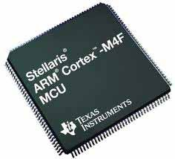
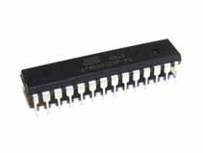
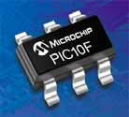
What is a Microcontroller (µC, MCU)
Computer on a single integrated chip
  Processor (CPU)
  Memory (RAM / ROM / Flash)
  I/O ports (USB, I2C, SPI, ADC)
Common microcontroller families:
– Intel: 4004, 8008, etc.
  Atmel: AT and AVR
  Microchip: PIC
  ARM: (multiple manufacturers)
Used in:
  Cellphones,
  Toys
  Household appliances
  Cars
  Cameras

Slide 3

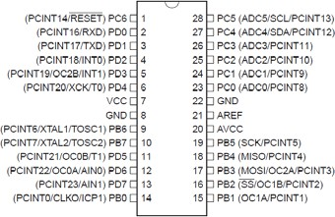
The ATmega328P Microcontroller
(used by the Arduino)
AVR 8-bit RISC architecture
Available in DIP package
Up to 20 MHz clock
32kB flash memory
1 kB SRAM
23 programmable I/O channels
Six 10-bit ADC inputs
Three timers/counters
Six PWM outputs

Slide 4
What is Arduino Not?
It is not a chip (IC)
It is not a board (PCB)
It is not a company or a manufacturer
It is not a programming language
It is not a computer architecture
(although it involves all of these things...)

Slide 5


So what is Arduino?
It’s a movement, not a microcontroller:
Founded by Massimo Banzi and David Cuartielles in 2005
Based on “Wiring Platform”, which dates to 2003
Open-source hardware platform
Open source development environment
  Easy-to learn language and libraries (based on Wiring language)
  Integrated development environment (based on Processing programming environment)
  Available for Windows / Mac / Linux

Slide 6
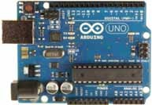
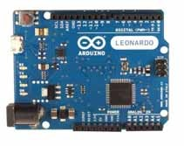
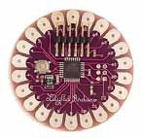
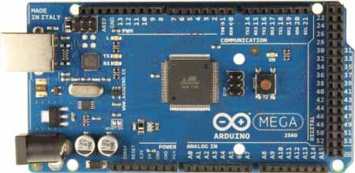



The Many Flavors of Arduino
Arduino Uno
Arduino Leonardo
Arduino LilyPad
Arduino Mega
Arduino Nano
Arduino Mini
Arduino Mini Pro
Arduino BT

Slide 7
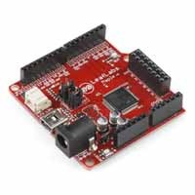
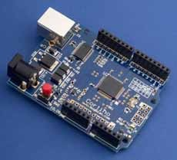
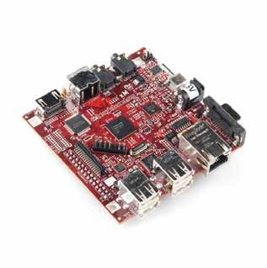
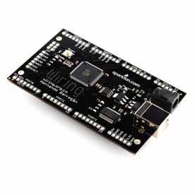
Arduino-like Systems
Cortino (ARM)
Xduino (ARM)
LeafLabs Maple (ARM)
BeagleBoard (Linux)
Wiring Board (Arduino predecessor)

Slide 8
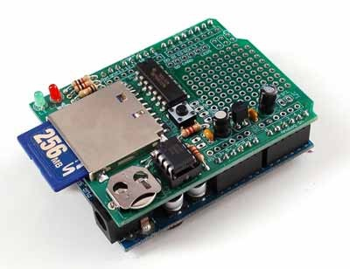
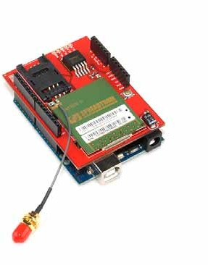
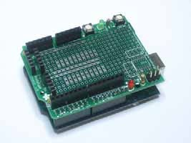
Arduino Add-ons (Shields)
TFT Touch Screen
Data logger
Motor/Servo shield
Ethernet shield
Audio wave shield
Cellular/GSM shield
WiFi shield
Proto-shield
...many more

Slide 9
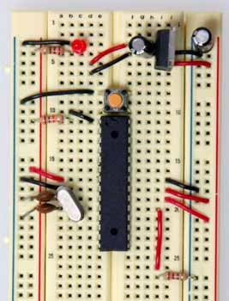
Where to Get an Arduino Board
Purchase from online vendor (available worldwide)
  Sparkfun
  Adafruit
  DFRobot
... or build your own
  PC board
  Solderless breadboard
http://itp.nyu.edu/physcomp/Tutorials/ArduinoBreadboard

Slide 10




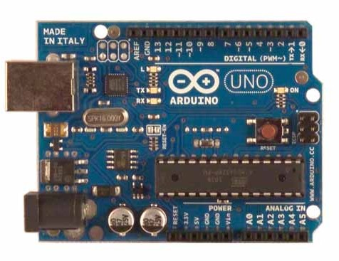







Getting to know the Arduino: Electrical Inputs and Outputs
Input voltage: 7-12 V (USB, DC plug, or Vin)
LED
14 digital inputs/outputs
(6 PWM outputs)
Max output current per pin: 40 mA
Power
indicator
USB connection
Reset Button
16 MHz clock
Voltage regulator
ATmega328P
AC/DC adapter jack
DC voltage supply (IN/OUT)
6 analog inputs

Slide 11
Download and Install
Download Arduino compiler and development environment from: http://arduino.cc/en/Main/Software
Current version: 1.0.1
Available for:
  Windows
  MacOX
  Linux
No installer needed... just unzip to a convenient location
Before running Arduino, plug in your board using USB cable (external power is not necessary)
When USB device is not recognized, navigate to and select the appopriate driver from the installation directory
Run Arduino

Slide 12
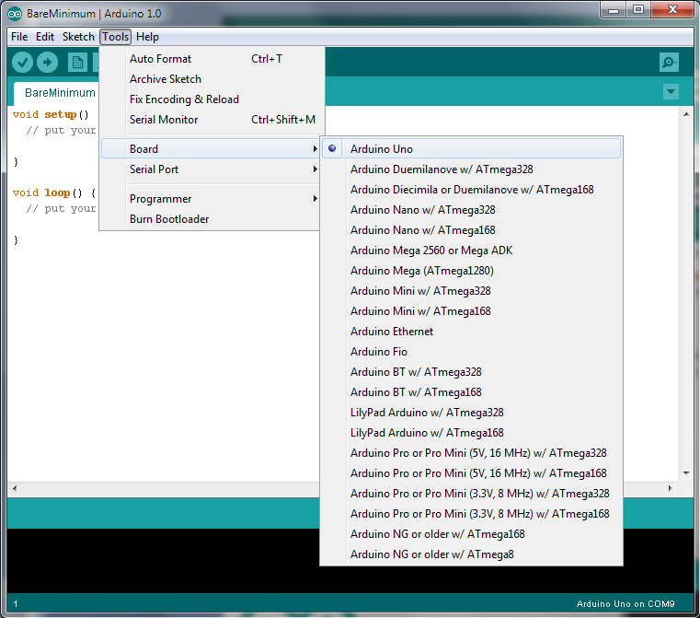
Select your Board

Slide 13
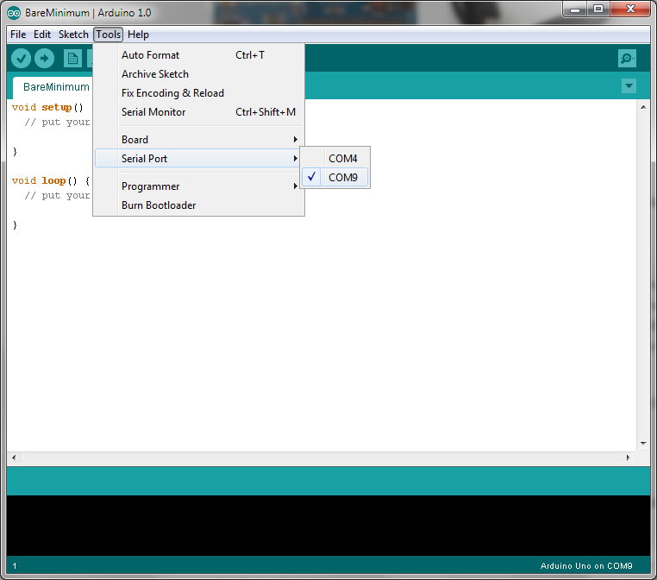
Select Serial Port

Slide 14
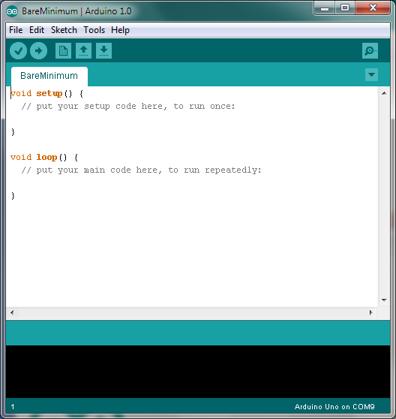
Elements of the Arduino IDE
Text editor
  syntax and keyword coloring
  automatic indentation
  programming shortcuts
Compiler
Hardware Interface
  Uploading programs
  Communicating with Arduino via USB

Slide 15
Using the Arduino IDE
Name of sketch Compile sketch
Upload to board
Serial Monitor
Program area
Save
New
Open
Messages / Errors

Slide 16
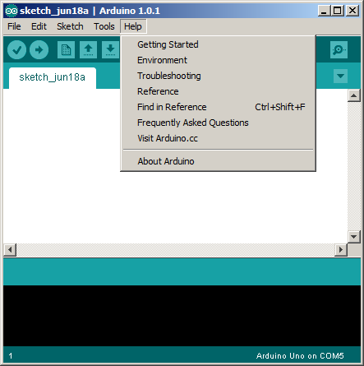
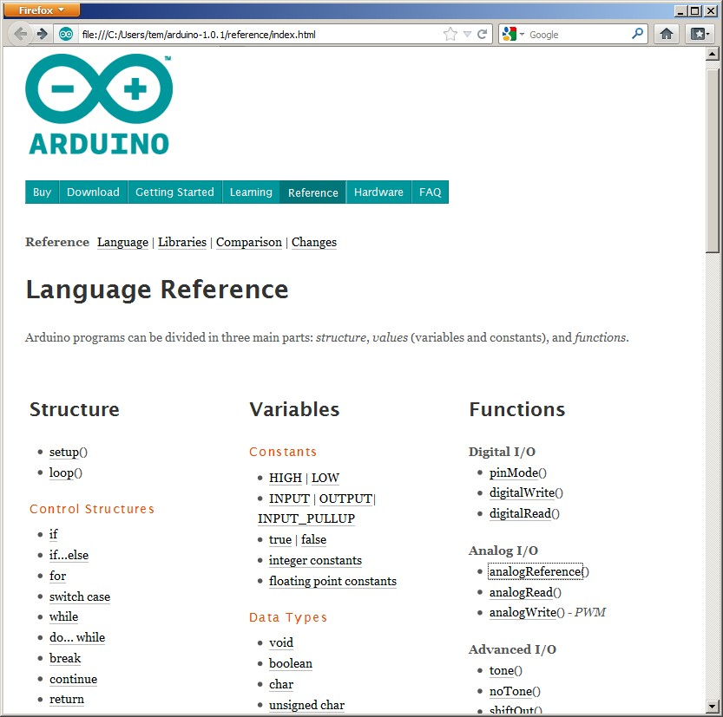
Arduino Reference
Arduino Reference is installed locally or available online at http://arduino.cc/

Slide 17



Arduino Sketch Structure
void setup()
  Will be executed only when the program begins (or reset button is pressed)
void loop()
  Will be executed repeatedly
void setup() {
// put your setup code here, to run once:
}
void loop() {
// put your main code here, to run repeatedly:
}
Text that follows // is a comment (ignored by compiler)
Useful IDE Shortcut: Press Ctrl‐/ to comment (or uncomment) a selected portion of your program.

Slide 18

Activity 1: LED Blink
Load the “Blink” example (File→Examples→Basics→Blink)
Use pin 13 as digital output
void setup() {
// initialize the digital pin as an output.
// Pin 13 has an LED connected on most Arduino boards: pinMode(13, OUTPUT);
}
Set output high (+5V)
void loop() { digitalWrite(13, HIGH); delay(1000); digitalWrite(13, LOW); delay(1000);
}
Wait 1000 milliseconds
// set the LED on
// wait for a second
// set the LED off
// wait for a second
Set output low (0V)
Compile, then upload the program
Congratulations! you are now blinkers!

Slide 19
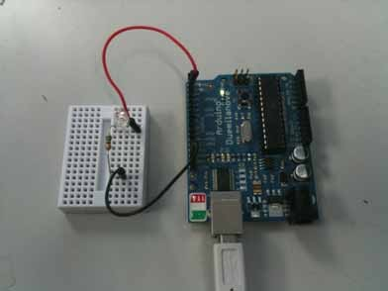
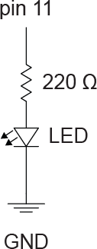
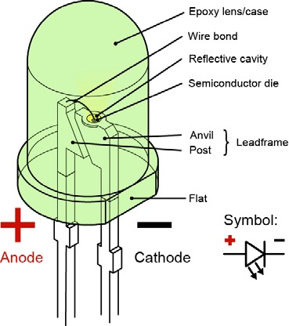
Now connect your own LED
Anatomy of an LED:
Notes:
Resistor is needed to limit current
Resistor and LED may be interchanged
(but polarity of LED is important)
Pin 13 is special: has built-in resistor and LED
Change program and upload
http://www.wikipedia.org/

Slide 20
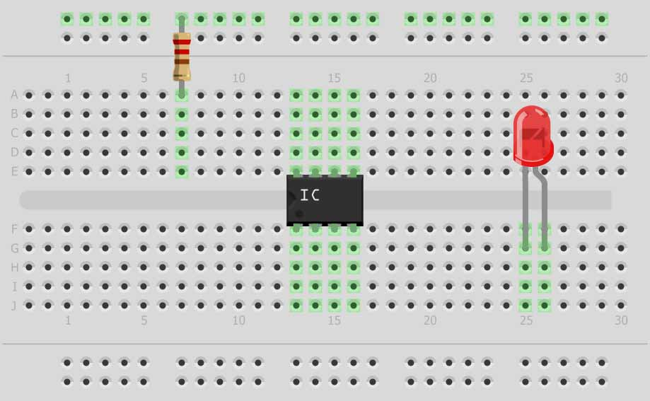



Aside: Using a Solderless Breadboard
Connected together
300 mils
Connected together

Slide 21
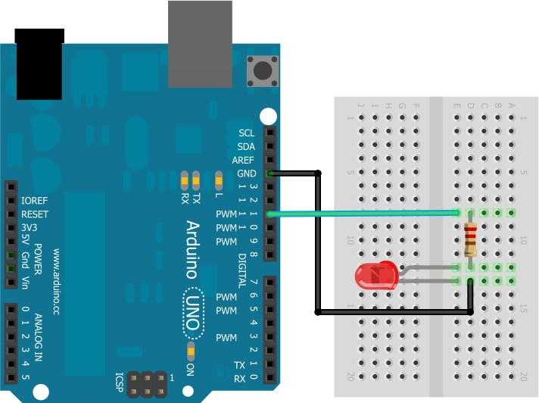
Example: Using a Solderless Breadboard

Slide 22
Experimenting
Change the blink rate
  how fast can the LED blink (before you can no longer perceive the blinking?)
How would you make the LED dimmer?
  (...without changing the resistor?)

Slide 23
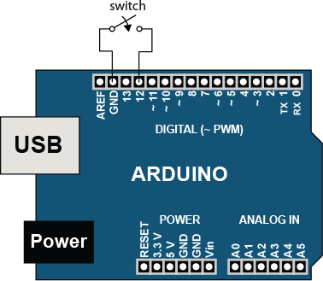


Digital Input: Reading Switches and Buttons
Writing HIGH to an input pin: enables an internal pull-up resistor
void setup() { pinMode(11, OUTPUT); pinMode(12, INPUT); digitalWrite(12, HIGH);
}
// Use pin 11 for digital out
// Use pin 12 for digital input
// Enable pull‐up resistor
void loop() { boolean state;
state = digitalRead(12); digitalWrite(11, state); delay(100);
}
// read state of pin 12
// set state of pin 11 (LED)
// wait for a 1/10 second
Turn on/off LED based on switch
Pin 12 reads LOW when switch is closed
Pin 12 reads HIGH when switch is open (pull-up)
Without the internal pull-up resistor, unconnected digital inputs could read either high or low

Slide 24
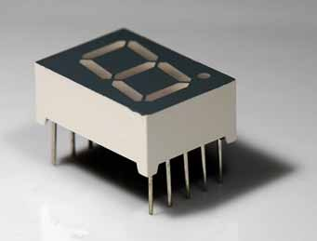


Activity 2: Seven-Segment Display
Write a that program that counts from 0 to 9 and displays the result on a seven- segment LED display
  Consider writing a function:
void writeDigit(int n)
that writes a single digit

Slide 25
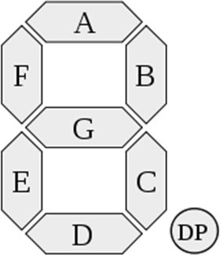
Seven-Segment Display Table
Digit | ABCDEFG | A | B | C | D | E | F | G
0 | 0×7E | on | on | on | on | on | on | off
1 | 0×30 | off | on | on | off | off | off | off
2 | 0×6D | on | on | off | on | on | off | on
3 | 0×79 | on | on | on | on | off | off | on
4 | 0×33 | off | on | on | off | off | on | on
5 | 0×5B | on | off | on | on | off | on | on
6 | 0×5F | on | off | on | on | on | on | on
7 | 0×70 | on | on | on | off | off | off | off
8 | 0×7F | on | on | on | on | on | on | on
9 | 0×7B | on | on | on | on | off | on | on
Useful:
bitRead(x,n)
Get the value of the n^{th} bit of an integer x
Example:
– bitRead(0x7E,7); // returns 1 (see table above)

Slide 26




Serial Communication - Writing
IMPORTANT:
USB serial communication is shared with Arduino pins 0
and 1 (RX/TX)
Serial.begin(baud)
•
Initialize serial port for communication (and sets baud rate)
Example:
Note: Serial.end() command is usually unnecessary, unless you need to use pins 0 & 1
– Serial.begin(9600); // 9600 baud
•
Serial.print(val), Serial.print(val,fmt)
Format can be: BIN, HEX, OCT,
or an integer specifying the number of digits to display
Prints data to the serial port
Examples:
Serial.print(“Hi”);
Serial.print(78);
Serial.print(variable); // works with variables
Serial.print(78,BIN); // will print 1001110
// print a string
// works with numbers, too
•
Serial.println(val)
Same as Serial.print(), but with line-feed

Slide 27
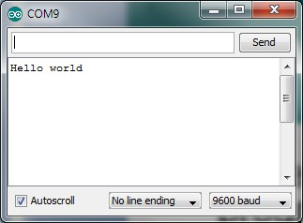

Activity 3: Hello World!
Write an Arduino program that prints the message “Hello world” to the serial port
...whenever you press a switch/button
Use the Serial Monitor to see the output
(Ctrl-Shift-M)
Try increasing baud rate
Serial Monitor:
Make sure this agrees with your program, i.e., Serial.begin(9600);

Slide 28
Serial Communication - Reading
Serial.available()
Returns the number of bytes available to be read, if any
Example:
if (Serial.available() > 0) {
data = Serial.read();
}
To read data from serial port:
•
•
•
•
letter = Serial.read()
letters = Serial.readBytesUntil(character, buffer, length)
number = Serial.parseInt() number = Serial.parseFloat()

Slide 29
Activity 4 – User Controlled Blinker
When available (Serial.available), read an integer from the serial port (Serial.parseInt), and use the result to change the blink rate of the LED (pin 13)
Useful:
constrain(x,a,b)
Constrains the variable x to be from a to b
Examples:
– constrain(5,1,10); | // | returns | 5
– constrain(50,1,10); | // | returns | 10
– constrain(0,1,10); | // | returns | 1

Slide 30





Analog Input and Sensors
Reference Voltage (optional)
Six analog inputs:
A0, A1, A2, A3, A4, A5
AREF = Reference voltage (default = +5 V)
10 bit resolution:
  returns an integer from 0 to 1023
  result is proportional to the pin voltage
All voltages are measured relative to GND
Analog Inputs
Note: If you need additional digital I/O, the analog pins can be re-assigned for digital use: pinMode(A0, OUTPUT);

Slide 31

Reading Analog Values
value = analogRead(pin)
Reads the analog measurement on pin Returns integer between 0 and 1023
analogReference(type) type can be:
  DEFAULT - the default analog reference of 5 volts (on 5V Arduino boards)
  INTERNAL – Built-in reference voltage (1.1 V)
  EXTERNAL – AREF input pin
Note: Do NOT use pinMode(A0, INPUT) unless you want to use A0 for DIGITAL input.

Slide 32
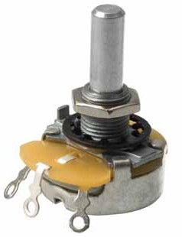
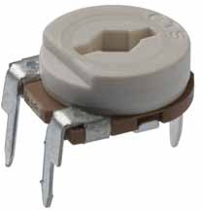
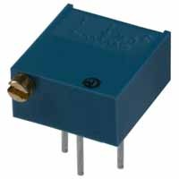
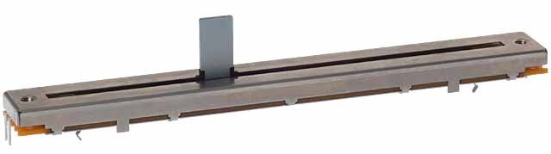
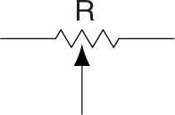
Aside: Potentiometers
(variable resistors, rheostats)

Slide 33
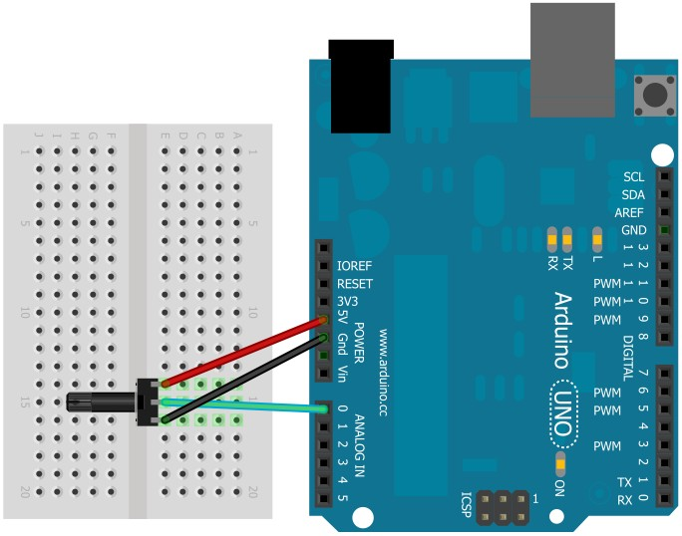
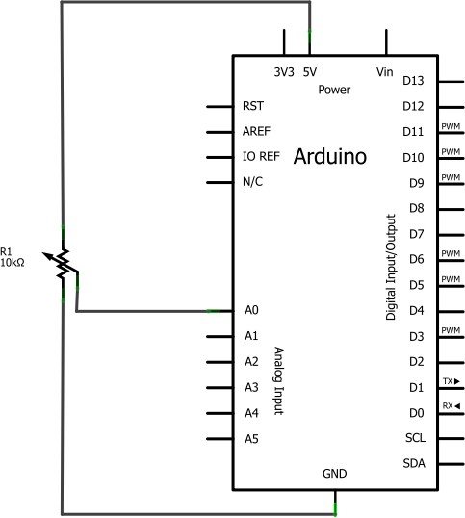
Activity 5 – Volume Knob
Connect the potentiometer from 5V to GND
Use analogRead(A0) to measure the voltage on the center pin
Set the LED blink rate depending on the reading

Slide 34
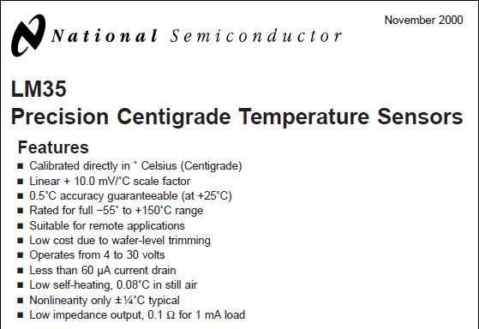
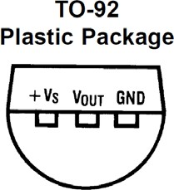
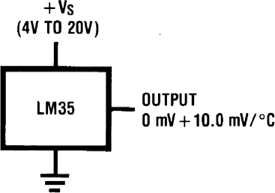
Activity 6 – Arduino Thermometer
Build a circuit and write a sketch to read and report the temperature at 1 second intervals

Slide 35

Data Logging Ideas
millis()
Returns the number of milliseconds elapsed since program started (or reset)
Time functions
Note: this uses the Time library:
#include <Time.h>
setTime(hr,min,sec,day,month,yr)
hour(), minute(), day(), month(), year()
Real-time Clock (RTC):
Use an external, battery-powered chip (e.g., DS1307) to provide clock

Slide 36
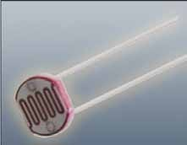
Activity 7 – Arduino Nightlight
CdS Photoresistor:
resistance depends on ambient light level
Build a circuit and write a sketch that turns on an LED whenever it gets dark
Hint: connect the photoresistor in a voltage divider

Slide 37
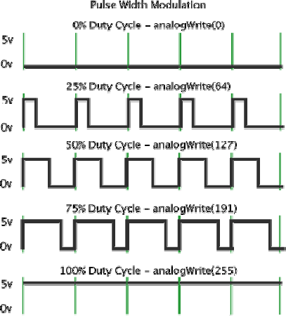
Analog Output?
Most microcontrollers have only digital outputs
Pulse-width Modulation: Analog variables can be represented by the duty- cycle (or pulse-width) of a digital signal
http://arduino.cc/en/Tutorial/PWM

Slide 38

PulseWidth Modulation (PWM)
PWM available on pins 3, 5, 6, 9, 10, 11
analogWrite(pin,val)
set the PWM fraction:
  val = 0: always off
  val = 255: always on
Remember to designate pin for digital output: pinMode(pin,OUTPUT);
(usually in setup)
Default PWM frequency:
– 16 MHz / 2¹⁵ = 488.28125 Hz
Note: the PWM frequency and resolution can be changed by re-configuring the timers

Slide 39
Activity 8 – PWM LED Dimmer
Use PWM to control the brightness of an LED
  connect LED to pin 3, 5, 6, 9, 10 or 11
  remember to use 220 Ω current-limiting resistor
Set the brightness from the serial port, or potentiometer
Watch the output on an oscilloscope
Useful:
newValue = map(oldValue, a, b, c, d)
Converts/maps a number in the range (a:b) to a new number in the range (c:d)
Example:
  newValue = map(oldValue,0,1023,0,255);

Slide 40
Activity 8 – PWM LED Dimmer (cont’d)
Change your program to sinusoidally modulate the intensity of the LED, at a 1 Hz rate
– Hint: use the millis(), sin() , and
analogWrite() functions

Slide 41
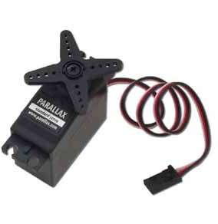
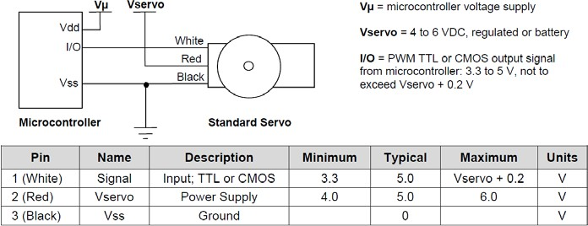
Servomotors
Standard servo:
  PWM duty cycle controls direction:
  0% duty cycle → 0 degrees
  100% duty cycle → 180 degrees
Continuous-rotation servo:
  duty cycle sets speed and/or direction
http://www.parallax.com/

Slide 42
Activity 9 – Servomotor Control
Build a program that turns a servomotor from 0 to 180 degrees, based on potentiometer reading
Report setting to the serial monitor

Slide 43
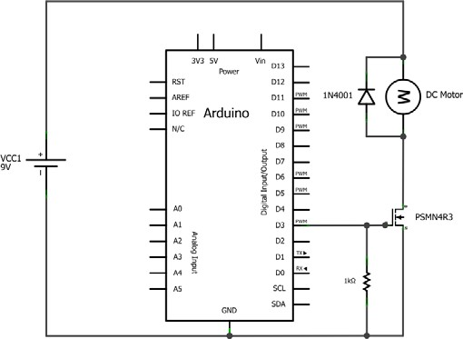
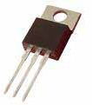
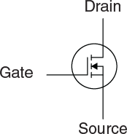
Solid State Switching - MOSFETs
D
G
D
S
Logic-level MOSFET (requires only 5 V)
Acts like a voltage- controlled switch
Works with PWM!

Slide 44
Activity 10 – PWM Speed Control
Build a circuit to control the speed of a motor using a PWM-controlled MOSFET
Enter the speed (PWM setting) from the serial port (Serial.parseInt)

Slide 45
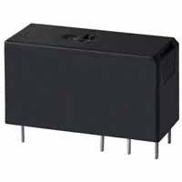
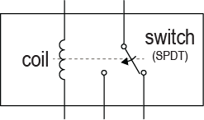

Controlling Relays and Solenoids
Electromechanically
-actuated switch
Provides electrical isolation
Typically few ms response time
Note: Arduino cannot supply enough current to drive relay coil

Slide 46


Relay Driver Circuit
NPN transistor: acts like a current-controlled switch
MOSFET will also work
Diode prevents back-EMF (associated with inductive loads)
Coil voltage supply and Arduino share common GND

Slide 47


Activity 11: Bidirectional Motor Driver
Build a circuit (and write an Arduino sketch) that will use a DPDT relay to change the direction of a DC motor:
Note: this is called an H-bridge circuit.
It can also be made with transistors

Slide 48

Communication: I²C, SPI
I²C (Inter-Integrated Circuit)
  Developed by Phillips
  Speed = 100 kHz, 400 kHz, and 3.4 MHz (not supported by Arduino)
  Two bi-directional lines: SDA, SCL
  Multiple slaves can share same bus
SPI (Serial Peripheral Interface Bus)
  Speed = 1-100 MHz (clock/device limited)
  Four-wire bus: SCLK, MOSI, MISO, SS
  Multiple slaves can share same bus
(but each needs a dedicated SS, slave select)

Slide 49


Connecting Multiple Devices (I²C and SPI)
Master with three SPI slaves:
Master (µC) with three I²C slaves:
http://en.wikipedia.org/

Slide 50




SPI and I²C on the Arduino
SCK (13)
MISO (12)
MOSI (11)
SS (10)
SPI pins:
SCK = serial clock
MISO = master in, slave out
MOSI = master out slave in
SS = slave select
I²C pins:
SDA = data line
SCL = clock line
SDA (A4)
SCL (A5)

Slide 51


Basic Arduino I²C Commands
COMMAND | EXPLANATION
Wire.begin() | Join the I²C bus as master (usually invoked in setup)
Wire.beginTransmission(address) | Begin communicating to a slave device
Wire.write(byte) | Write one byte to I²C bus (after request)
Wire.endTransmission(address) | End transmission to slave device
Note: you must include the Wire library:
#include <Wire.h>
Note: pinMode() not needed for I²C on pins A4 and A5

Slide 52



Example: MCP4725 12-bit DAC
MCP4725 write command (taken from data sheet)
7-bit I²C address (1100000)
command power down mode (010) (00)
data bits (MSB → LSB)
Note: binary numbers are preceded by B: B1100000 = 96
Arduino program segment:
data >> 4: shift bits left by four positions
Wire.beginTransmission(B1100000); Wire.write(B01000000); Wire.write(data >> 4);
// Byte 1 (Initiate communication)
// Byte 2 (command and power down mode)
// Byte 3 (send bits D11..D4)
Wire.write((data & B00001111) << 4); // Byte 4 (send bits D3..D0) Wire.endTransmission();
Remember: you must include the Wire library at the top:
#include <Wire.h>
and you must also use Wire.begin() in setup

Slide 53
Additional I²C Commands
COMMAND | EXPLANATION
Wire.begin() | Join the I²C bus as master (usually invoked in setup)
Wire.begin(address) | Join the I²C bus as slave, with address specified (usually invoked in setup)
Wire.beginTransmission(address) | Begin communicating to a slave device
Wire.write(byte) | Write one byte to I²C bus (after request)
Wire.write(bytes,length) | Write length bytes to I²C bus
Wire.endTransmission(address) | End transmission to slave device
Wire.requestFrom(address, quantity) Wire.requestFrom(address, quantity, stop) | Request bytes (quantity) from slave
Wire.available() | The number of bytes available for reading
Wire.read() | Reads a byte that was transmitted from a slave. (Preceded by Wire.requestFrom)
Note: you must include the Wire library:
#include <Wire.h>
Note: pinMode() not needed for I²C on pins A4 and A5

Slide 54




Activity 12: Sawtooth Wave
Program the MCP4725 DAC to produce a sawtooth (ramp) wave:
  What is the frequency of the sawtooth wave?
  Can you make f = 100 Hz?
MCP4725
breakout board:
Note: the I²C bus requires pull- up resistors on SCL and SDA (provided on the board)
http://www.sparkfun.com/

Slide 55


Basic Arduino SPI Commands
COMMAND | EXPLANATION
SPI.begin() | Initializes the SPI bus, setting SCK, MOSI, and SS to outputs, pulling SCK and MOSI low and SS high.
byteIn = SPI.transfer(byteOut) | Transfer one byte (both send and receive) returns the received byte
Note: you must include the SPI library:
#include <SPI.h>
Note: pinMode() not needed. It is automatically configured in SPI.begin()

Slide 56

Additional Arduino SPI Commands
COMMAND | EXPLANATION
SPI.begin() | Initializes the SPI bus, setting SCK, MOSI, and SS to outputs, pulling SCK and MOSI low and SS high.
SPI.end() | Disables the SPI bus (leaving pin modes unchanged) – in case you need to use pins 10-13 again
SPI.setBitOrder(order) | Set bit order for SPI order = {LSBFIRST, MSBFIRST}
SPI.setClockDivider(divider) | Set the SPI clock divider divider = {2, 4, 8, 16, 32, 64, 128} SPI clock speed = 16 MHz/divider
SPI.setDataMode(mode) | Set the SPI data mode mode = {SPI_MODE0, SPI_MODE1, SPI_MODE2, SPI_MODE3}
SPI.transfer(byte) | Transfer one byte (both send and receive) returns the received byte
Note: you must include the SPI library:
#include <SPI.h>
Note: pinMode() not needed

Slide 57

Example: AD5206 Digital Potentiometer
Functional block diagram:
Features:
six independent, 3- wiper potentiometers
8-bit precision
(256 possible levels)
Available in 10kΩ, 50kΩ and 100kΩ
Programmed through SPI interface

Slide 58



AD5206 Write Sequence
Note: same as MOSI (master out slave in)
Note: same as SS (slave select)
Arduino program segment:
SPI.begin(); | // | initialize SPI (in setup)
...
digitalWrite(SS,LOW); | // | hold SS pin low to select chip
SPI.transfer(potnumber); | // | determine which pot (0..5)
SPI.transfer(wipervalue); | // | transfer 8‐bit wiper setting
digitalWrite(SS,HIGH); | // | de‐select the chip

Slide 59
Activity 13: Programmable Voltage Divider
Use the AD5206 to build a programmable voltage divider
Allow the user to set the resistance from the serial port
Measure resistance with an Ohm meter, or using analogRead()

Slide 60



AD5206: Summary of Pins and Commands
SCK (13) MISO (12) MOSI (11) SS (10)
Remember: SPI.begin() needed in setup() and #include <SPI.h>
digitalWrite(SS,LOW); // hold SS pin low to select chip SPI.transfer(potnumber); // determine which pot (0..5) SPI.transfer(wipervalue); // transfer 8‐bit wiper setting digitalWrite(SS,HIGH); // de‐select the chip

